Slide 1
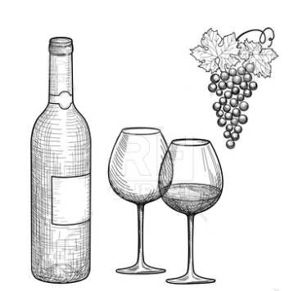
Wine analytics
BETSY BROWN, KURT SHIPLE, RAGAVENDAR KUMAR
UNC DATA ANALYTICS BOOTCAMP

Slide 2
AGENDA
METADATA
QUANTITATIVE INSIGHTS
QUALITATIVE INSIGHTS

Slide 3
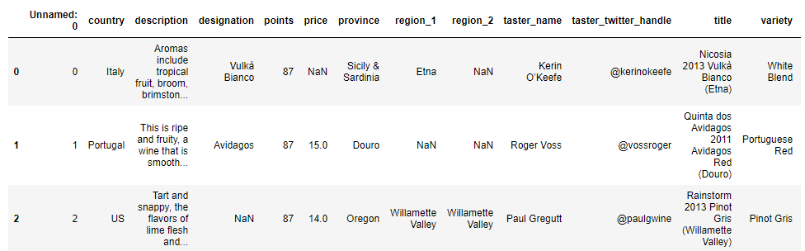
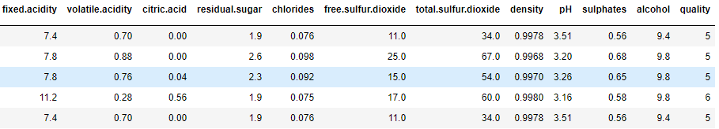
DATA OVERVIEW

Slide 4
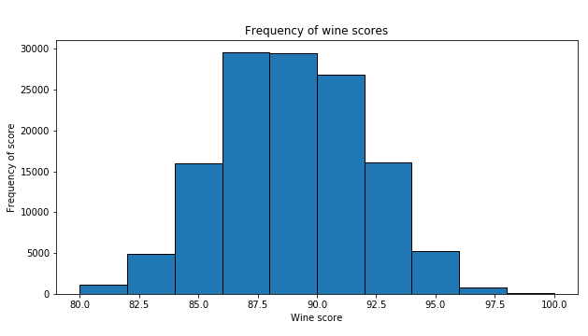
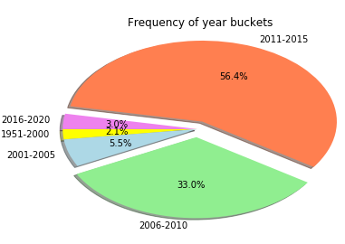
LIMITATIONS
Wine prices prior to 1950 were not accounted for inflation

Slide 5
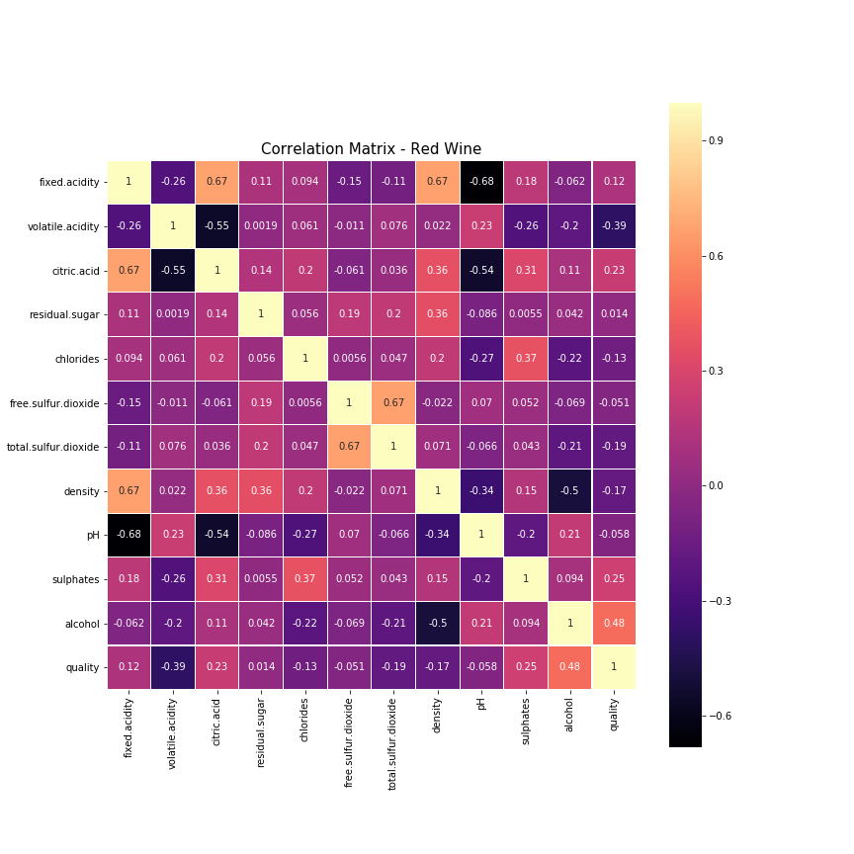
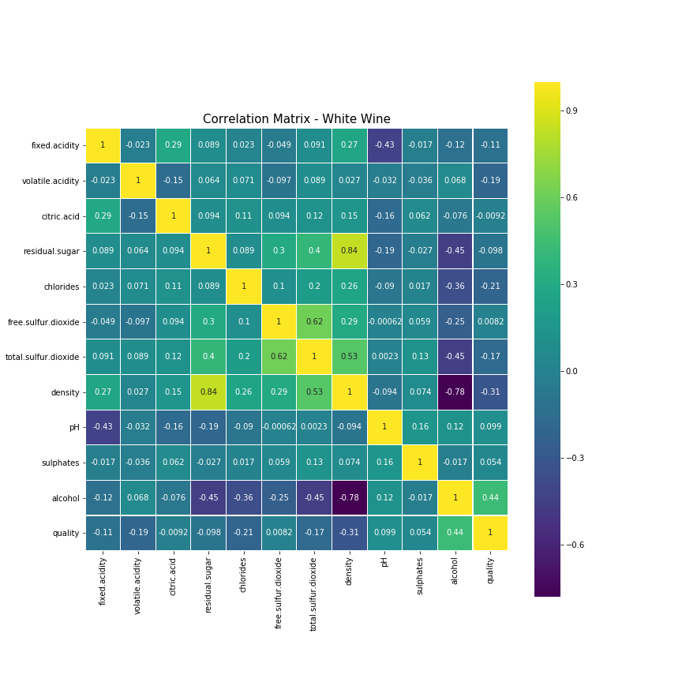
CHEMICAL COMPOSITION & QUALITY
Correlation Matrix – Red Wine
Correlation Matrix – White Wine

Slide 6
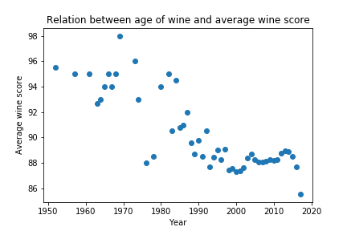
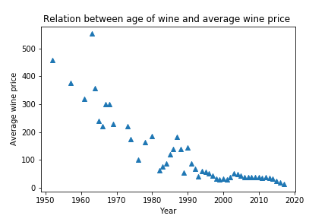
AGE – QUALITY AND PRICE

Slide 7
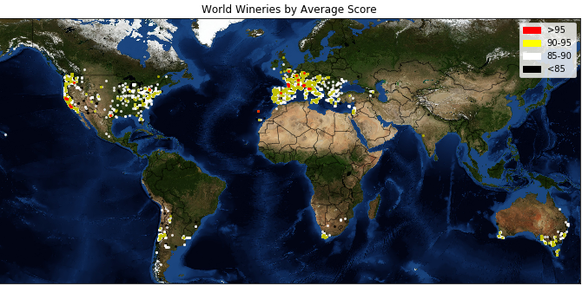
VALUE AND VARIETY

Slide 8
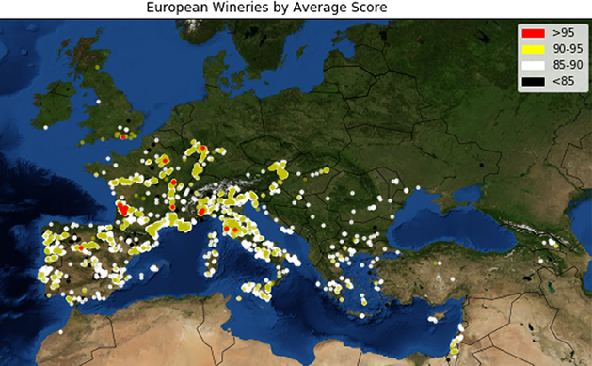
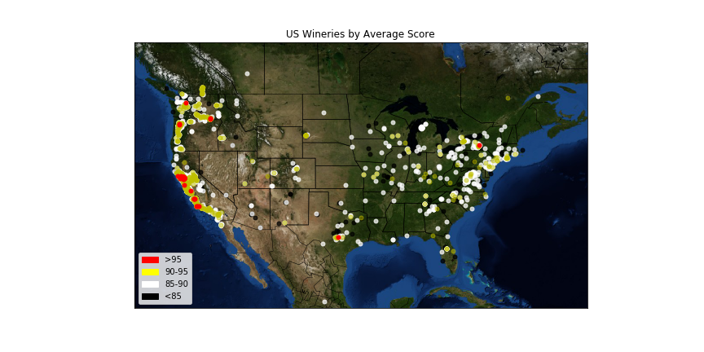
VALUE AND VARIETY

Slide 9
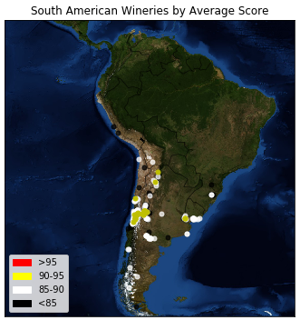
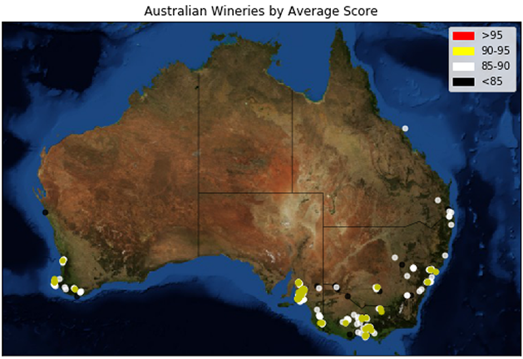
VALUE AND VARIETY

Slide 10
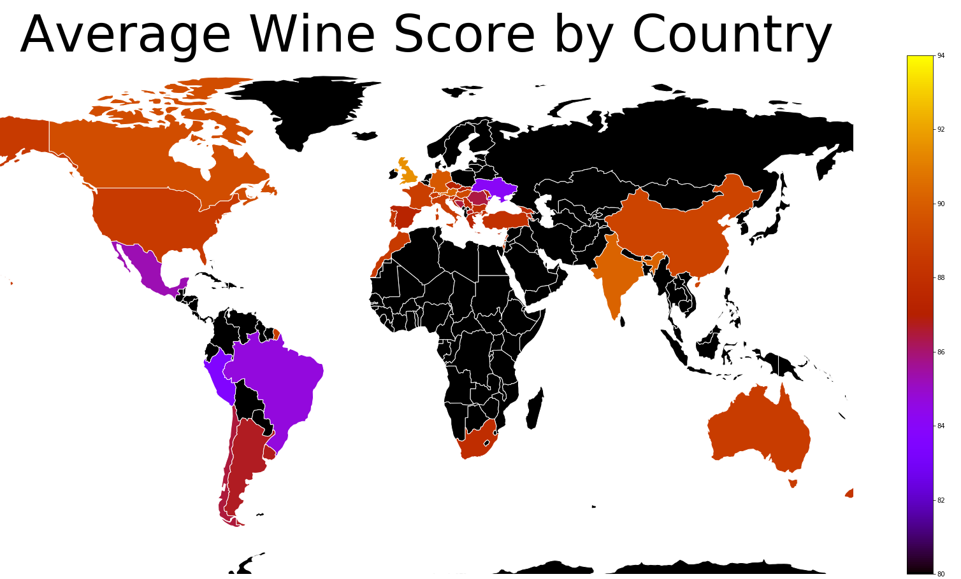
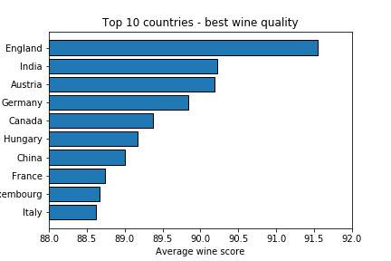
QUALITY BY LOCATION

Slide 11
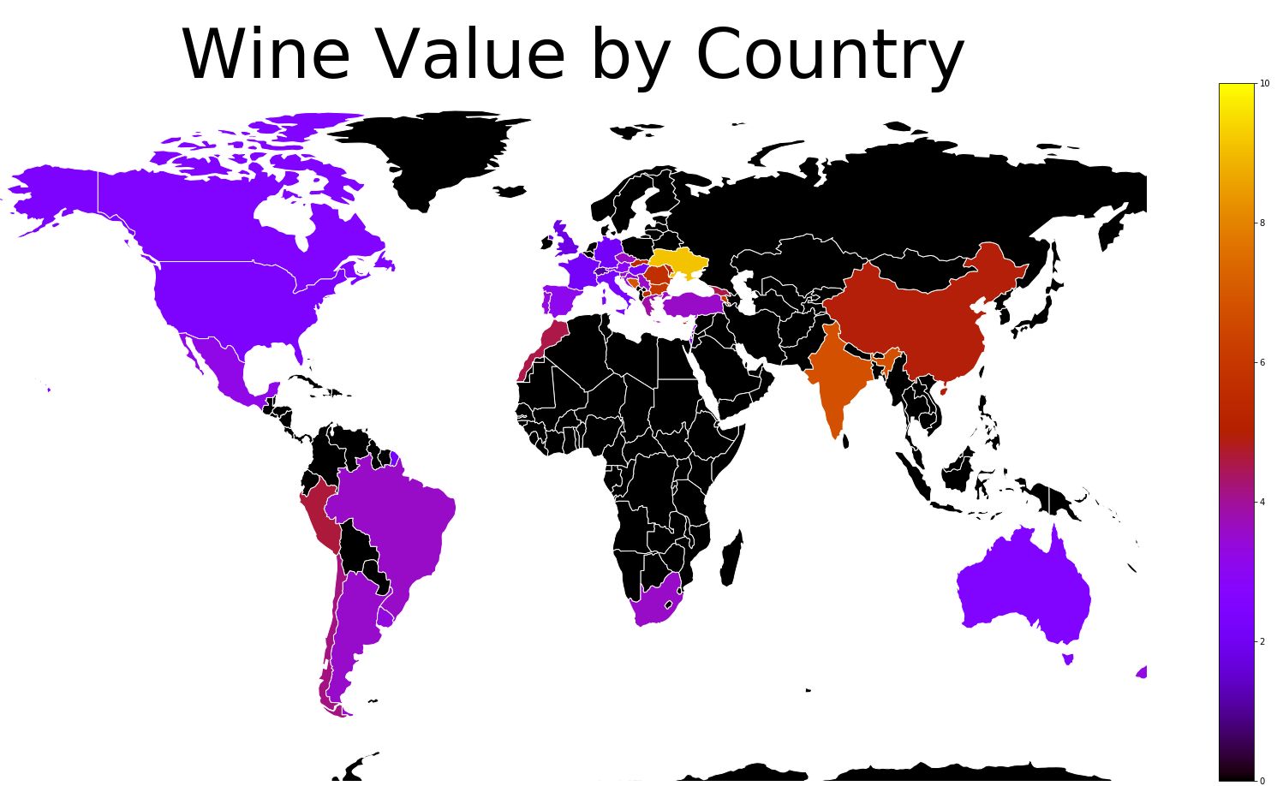
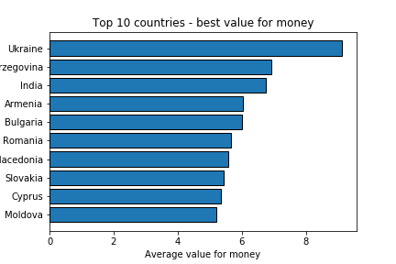
VALUE FOR MONEY BY LOCATION

Slide 12
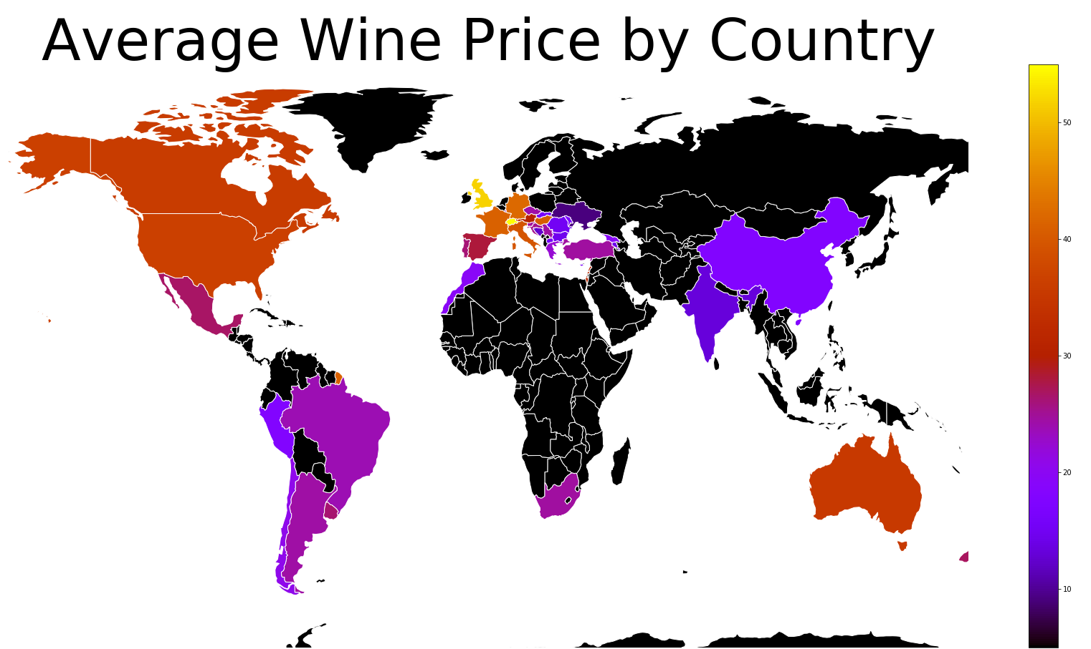
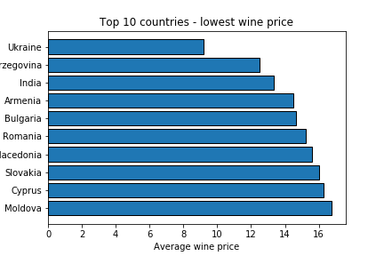
PRICE BY LOCATION

Slide 13
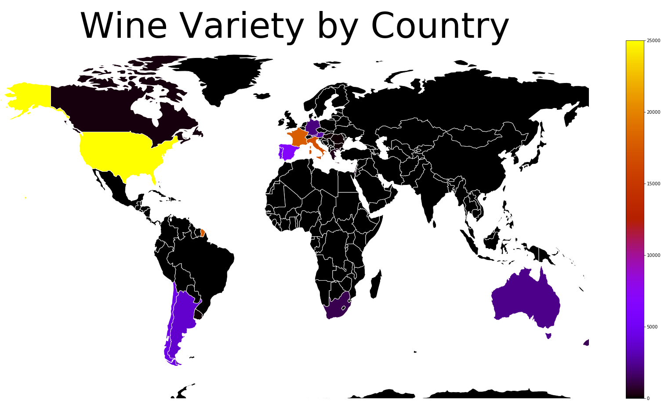
VARIETY BY LOCATION

Slide 14
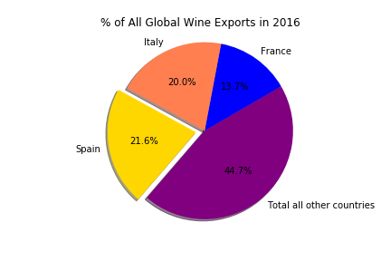
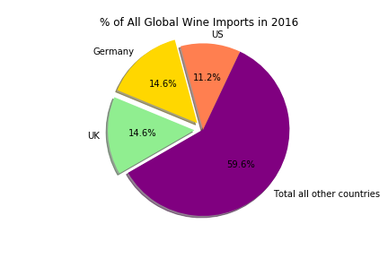
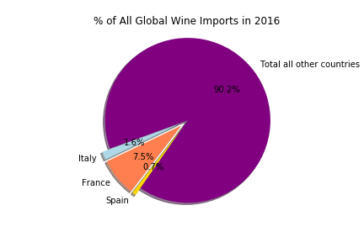
IMPORTS AND EXPORTS

Slide 15
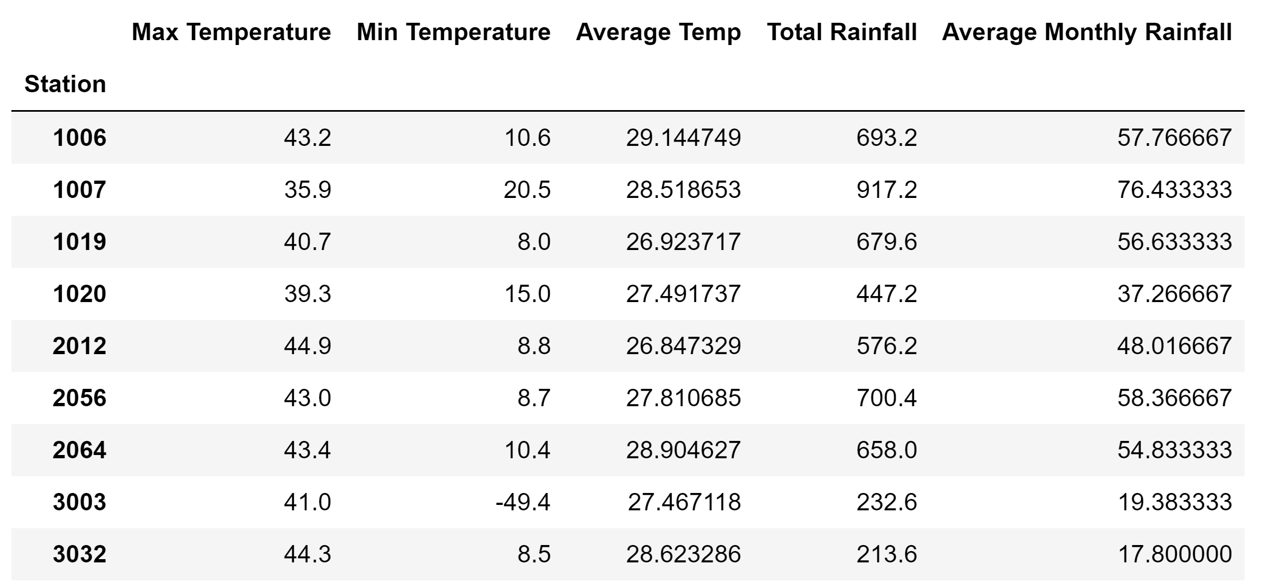
WEATHER AND WINE QUALITY DOWN UNDER

Slide 16
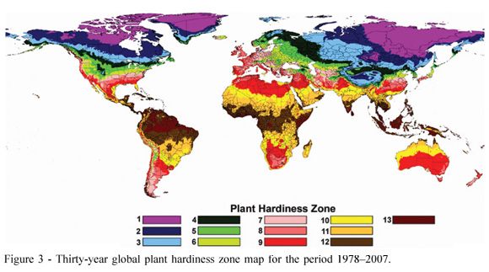
WEATHER AND WINE QUALITY DOWN UNDER

Slide 17
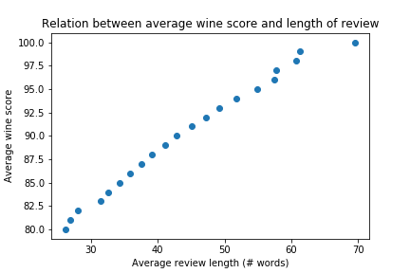
REVIEW LENGTH - QUALITY

Slide 18
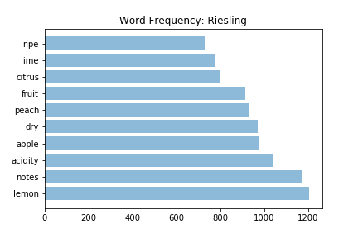
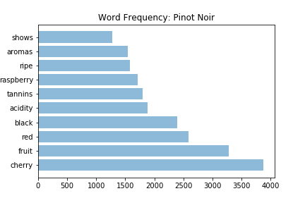
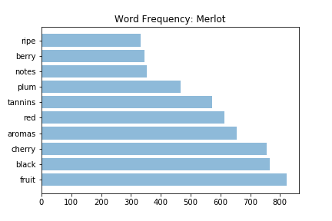
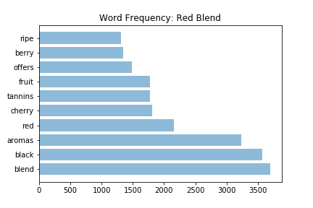
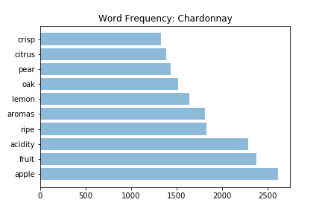
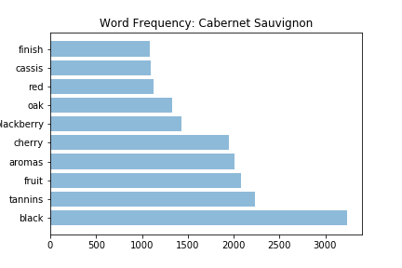
PALATE AND PREFERENCES

Slide 19
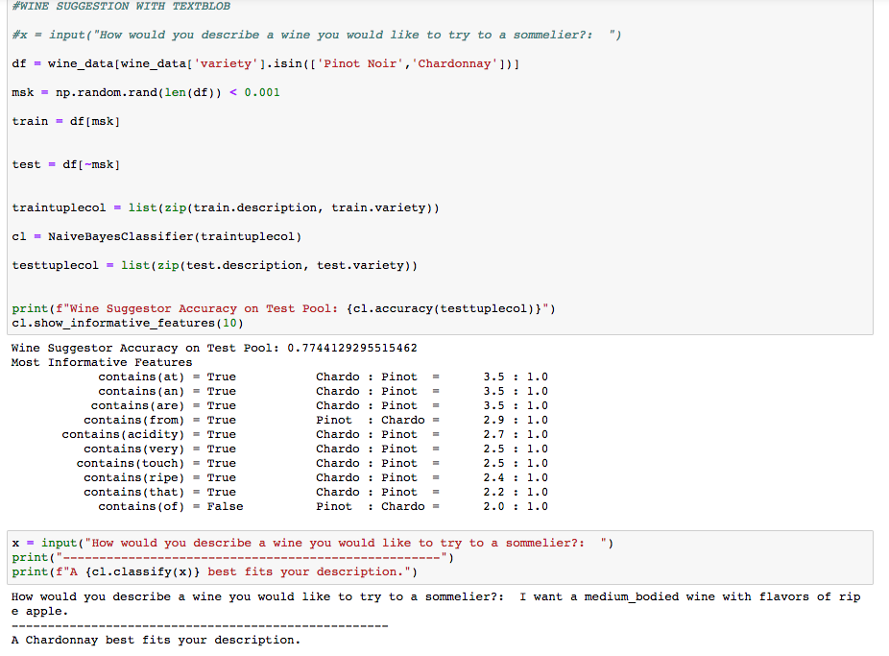
WINE SOMMELIER

Slide 20
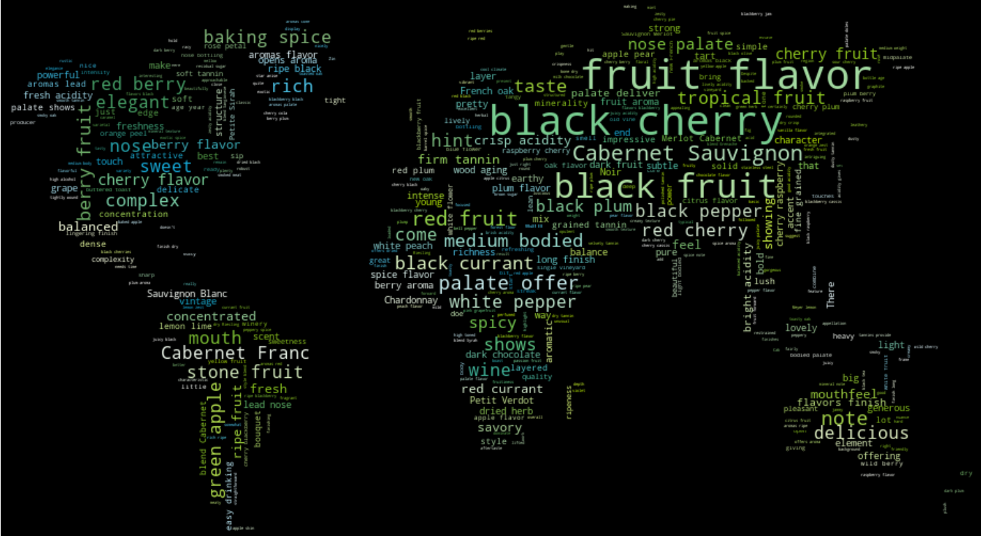
WORD CLOUD

Slide 21







DATA SOURCES
Multi-sheet Excel file
CSVs
APIs

Slide 22
QUESTIONS

